Slide 1
Thesis Title
Presenter: Rozhan Ahmadi
Supervisor: Prof. Kasaei
February 2024
Sharif University of Technology
Image Processing Lab (IPL)

Slide 2
01
Introduction
02
Literature Review
03
Proposed Method
Table
of Content
04
Experimental Results
05
Conclusion & Future Directions
06
References
07
Appendix
02/40

Slide 3
Introduction

Slide 4
Problem Definition & Challenges
Semantic Segmentation
Weak Supervision
Crucial task in computer vision
…
Utilizes weak labels
…
Weaknesses of WSSS
Distinguishing FG from BG
Complete Object Coverage
B. Zhou, et al. "Scene parsing ...", CVPR, 2017.
S. Lee, et al. “Railroad is not a train”, CVPR, 2021.
Distinguishing FG from FG
Q. Chen, et al. "Self-supervised image-specific ... ", CVPR, 2022.
Introduction
Literature
Proposed
Results
Conclusion
03/40

Slide 5
Problem Definition
Ideas
Convolutional Neural Network
Vision Transformer
Hierarchical Vision Transformer
Introduction
Literature
Proposed
Results
Conclusion
04/40

Slide 6
Main Contributions
Ideas
Proposing
S
S
Validating
Introduction
Literature
Proposed
Results
Conclusion
05/40

Slide 7
Literature Review

Slide 8
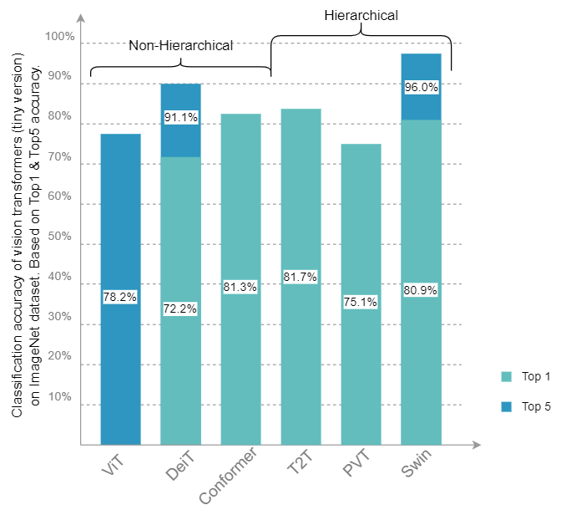
Main Available Methods
Ideas
ViT
A. Dosovitskiy, et al. “An image is worth 16x16 words …”, arXiv preprint, 2020.
Introduction
Literature
Proposed
Results
Conclusion
06/40

Slide 9
Categories of Available Methods
Ideas
Image Classification
FCN
Image Level
Image Generation
U-Net
Image Captioning
DeepLab
Fully Supervised
SAM
Semi Supervised
Computer Vision
Object Localization
Bounding Box
Object Detection
Weakly Supervised
Scribble
Pixel Level
Semantic Segmentation
Un-Supervised
Points
Instance Segmentation
Self Supervised
Image-level Labels
Panoptic Segmentation
Introduction
Literature
Proposed
Results
Conclusion
07/40

Slide 10
Title
Ideas
Localization Map Refinement
Refining the seed CAMs before semantic segmentation
Iterative Random Walk
Learning Pair-wise Semantic Affinity
Introduction
Literature
Proposed
Results
Conclusion
09/40

Slide 11
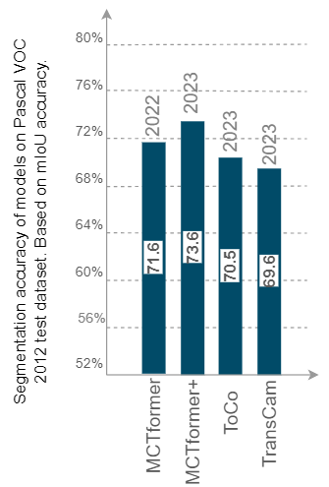
Title
Ideas
MCTformer
Multi-class Token Transformer for Weakly Supervised Semantic Segmentation
L. Xu, et al.,” Multi-class token transformer for weakly supervised semantic segmentation”, CVPR, 2022.
Introduction
Literature
Proposed
Results
Conclusion
11/40

Slide 12
Proposed Method

Slide 13
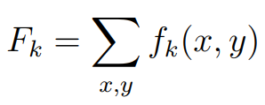
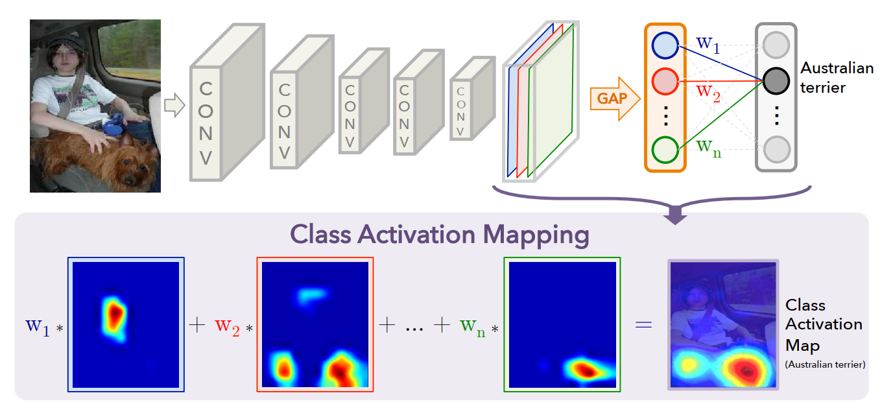
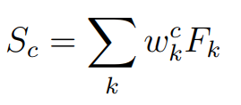
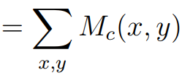
Method
B. Zhou, et al.,” Learning deep features for discriminative localization”, CVPR, 2016.
Ideas
Formula: (3-1)
Introduction
Literature
Proposed
Results
Conclusion
12/40

Slide 14
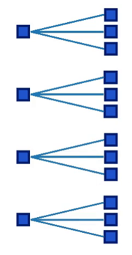
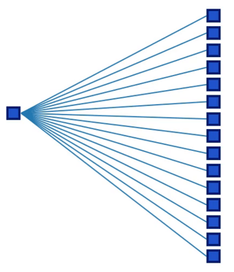
Method
Based on: Z. Liu, et al.,” Swin transformer: Hierarchical vision transformer using shifted windows”, ICCV, 2021.
W-MSA
MSA
Introduction
Literature
Proposed
Results
Conclusion
14/40

Slide 15
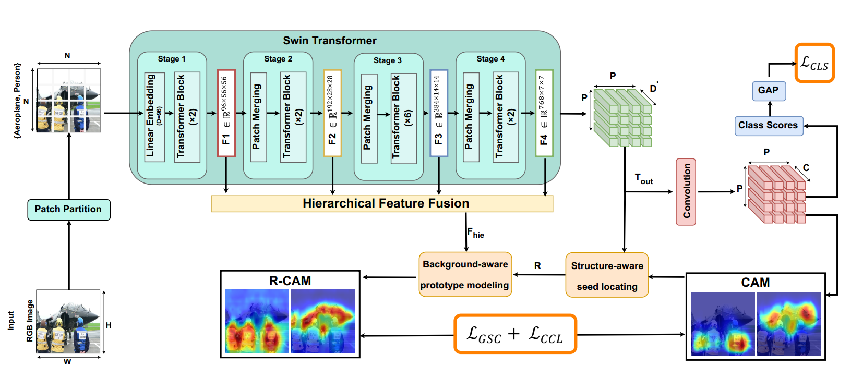
Title
Formula: (3-3)
$$F_{out}$$
$$y\left(c\right)=\frac{1}{D}\sum_{j}^{D}{F_{out}\left(c,j\right)}$$
$$C_{out}$$
$$c ∈\{1, 2, …, C\}$$
L. Xu, et al.,” Multi-class token transformer for weakly supervised semantic segmentation”, CVPR, 2022.
Q. Chen, et al.,” Self-supervised image-specific prototype exploration for weakly supervised
semantic segmentation”, CVPR, 2022.
Introduction
Literature
Proposed
Results
Conclusion
16/40

Slide 16
Title
HFF_3 and HFF_5 based on:
T. Chen and L. Mo,” Swin-fusion: swin-transformer with feature fusion for human action recognition”, Springer Neural Processing Letters, 2023.
Introduction
Literature
Proposed
Results
Conclusion
23/40

Slide 17
Experimental Results

Slide 18
Datasets
Ideas
PASCAL VOC 2012
Benchmark for weakly supervised semantic segmentation
Used to fine-tune backbone model and semantic segmentation
Contains:
Images: 4,369
Train: 1,464
Validation: 1,449
Test: 1,456
Additional train: 10,582
Class categories: 20
M. Everingham, et al.,” The pascal visual object classes (voc) challenge”, Springer International journal of computer vision, 2010.
Introduction
Literature
Proposed
Results
Conclusion
24/40

Slide 19
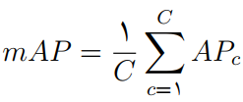
Evaluation Metrics
Ideas
Formula: (4-1)
mAP
mean Average Precision
Evaluates the localization accuracy of
the classification network.
Formula: (4-2)
mIoU
mean Intersection over Union
Evaluates the accuracy of the generated
class activation maps.
Introduction
Literature
Proposed
Results
Conclusion
26/40

Slide 20
Implementation Details
Ideas
Models
Training Input
Training
Classification model: Swin Transformer
Random Crop: $224 ×224$
No. of Epochs: $224 ×224$
Batch Size: $16$
Version: Swin-T
Augmentation: Random Flip
Optimizer: AdamW
Pre-trained: ImageNet-1k dataset
Augmentation: Color Jitter: 0.4
Scaler: NativeScaler
Resolution:$224 ×224$
Augmentation: Random Flip
LR Scheduler: CosineLRScheduler
Parameters:$28 million$
Generation Input
Base LR:$1×{10}^{−5}$
FLOPs:$4.5 G$
$$×1.0$$
Min LR:$5×{10}^{−6}$
$$×1.5$$
FPS:$755$
Scales:
$$×2.0$$
Weight Decay: $0.05$
Refinement Method: PSA
$$×2.5$$
GPU: $2 ×$ NVIDIA Tesla T4 (16GB RAM )
Introduction
Literature
Proposed
Results
Conclusion
27/40

Slide 21
Experiments – …
Ideas
Evaluation of the initial seed localization maps (Seed) on the PASCAL VOC 2012 train set in terms of mIoU. | Evaluation of the initial seed localization maps (Seed) on the PASCAL VOC 2012 train set in terms of mIoU.
Method | Method | Year | Backbone | mIoU (%)
CNN | PSA | 2018 | VGG-16 | $$48.00$$
 | IRN | 2019 | ResNet-50 | $$48.30$$
 | SEAM | 2020 | ResNet-38 | $$47.43$$
 | SC-CAM | 2020 | ResNet-101 | $$50.90$$
 | SIPE | 2022 | ResNet-50 | $$50.10$$
Transformer | MCTformer-V1 | 2022 | DeiT-S | $$47.20$$
 | MCTformer-V2 | 2022 | DeiT-S | $$48.51$$
 | TransCam | 2023 | Conformer | $$51.70$$
 | SWTformer-V1 | 2024 | Swin-T | $$49.84 {(+0.82)}_{avg}$$
 | SWTformer-V2 | 2024 | Swin-T | $$55.16 (+5.32)$$
Introduction
Literature
Proposed
Results
Conclusion
29/40

Slide 22
Ablation Studies – Effectiveness of …
Ideas
Formula: (3-4)
Ablation study on the effectiveness of the proposed cosine similarity on the accuracy of the seed map.
 | ReLU | Cosine Similarity
mIoU (%) | $$53.86$$ | $$55.16$$
SIPE
SWTformer
Introduction
Literature
Proposed
Results
Conclusion
31/40

Slide 23
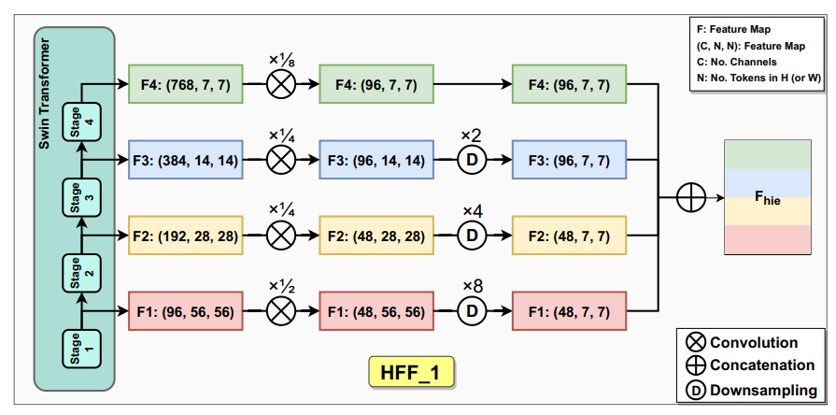
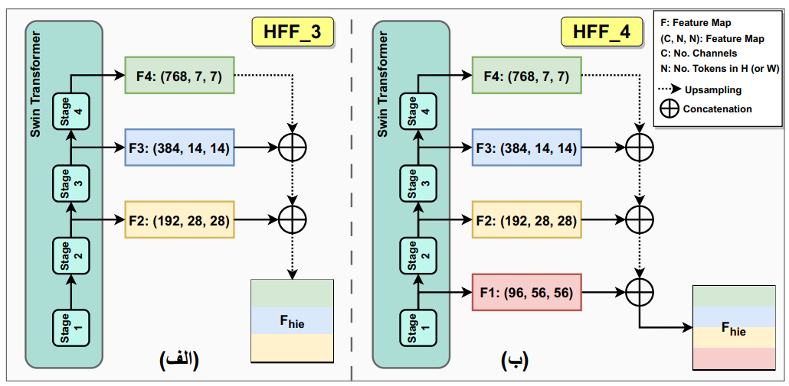
Ablation Studies – Effectiveness of …
Ideas
Ablation study on the effectiveness of the proposed hierarchical feature fusion methods on the accuracy of the seed map.
 | HFF_1 | HFF_2 | HFF_3 | HFF_4 | HFF_5 | HFF_6
mIoU (%) | $$50.21$$ | $$50.96$$ | $$51.27$$ | $$51.84$$ | $$53.38$$ | $$55.16$$
Introduction
Literature
Proposed
Results
Conclusion
32/40

Slide 24
Ablation Studies – Effectiveness of …
Ideas
Ablation study on the effectiveness of the proposed image scales on the accuracy of the seed map. |  |  | Ablation study on the effectiveness of the proposed image scales on the accuracy of the seed map.
$$×0.5$$ | $$×1.0$$ | $$×1.5$$ | $$×2.0$$ | $$×2.5$$ | $$×3.0$$ | mIoU (%)
✓ |  |  |  |  |  | $$40.96$$
 | ✓ |  |  |  |  | $$49.35$$
 |  | ✓ |  |  |  | $$50.67$$
 |  |  | ✓ |  |  | $$49.69$$
✓ | ✓ | ✓ | ✓ |  |  | $$53.38$$
 | ✓ | ✓ | ✓ |  |  | $$53.49$$
 |  | ✓ | ✓ |  |  | $$52.54$$
 | ✓ | ✓ | ✓ | ✓ | ✓ | $$55.41$$
 | ✓ | ✓ | ✓ | ✓ |  | $$55.16$$
Introduction
Literature
Proposed
Results
Conclusion
33/40

Slide 25
Qualitative Results
Ideas
Introduction
Literature
Proposed
Results
Conclusion
34/40

Slide 26
Conclusions
&
Future Directions

Slide 27
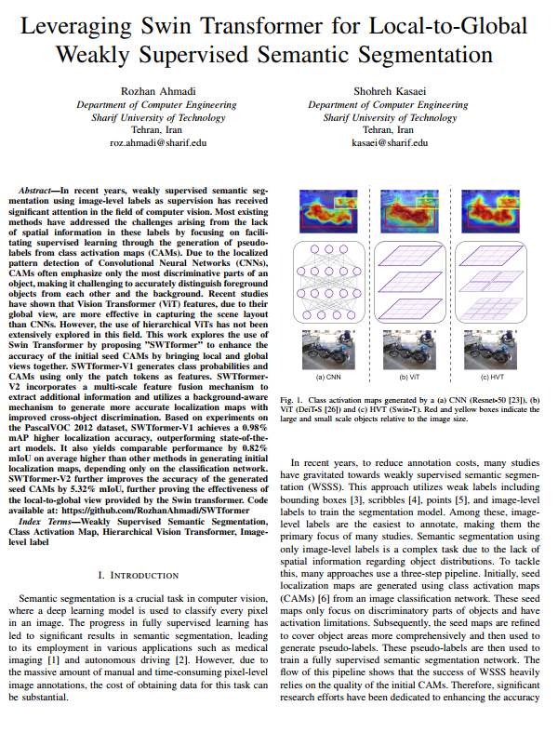
Conclusions
Ideas
Publication
Submitted to 13th Iranian & 3rd International Conference on Machine Vision and Image Processing (MVIP 2024) → (Under Review)
Link: https://arxiv.org/abs/2401.17828
Presented a novel approach “SWTformer” to utilizing the Swin Transformer as a backbone for weakly supervised semantic segmentation.
SWTformer-V1 captures both local fine-grained details and global structure by leveraging the hierarchical flow of the transformer.
SWTformer-V1 outperforms state-of-the-art transformers in object localization and yields comparable results in generating seed activation maps.
SWTformer-V2 addresses the limitations of refining activation maps with the transformer’s attention flow.
SWTformer-V2 introduces a hierarchical feature fusion module and
employs it in a modified version of a background-aware mechanism.
SWTformer-V2 further enhances SWTformer-V1 this framework by refining the initial activation maps to cover object regions more comprehensively.
Introduction
Literature
Proposed
Results
Conclusion
35/40

Slide 28
Future Directions
Ideas
Employing Attention Maps
Dynamic Multi Scale CAM Generation
Image
MCTFormer
W-MSA
SWTformer
SW-MSA
Introduction
Literature
Proposed
Results
Conclusion
36/40

Slide 29
References

Slide 30
References
Ideas
S. Lee, et al. Railroad is not a train: Saliency as pseudo-pixel supervision for weakly supervised semantic segmentation. CVPR, 2021.
…
37/40

Slide 31
Any Questions?

Slide 32
Appendix

Slide 33
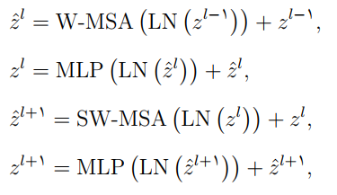
Title
Based on: Z. Liu, et al.,” Swin transformer: Hierarchical vision transformer using shifted windows”, ICCV, 2021.
MSA
SW-MSA
Introduction
Literature
Proposed
Results
Conclusion
A1

